Slide 2
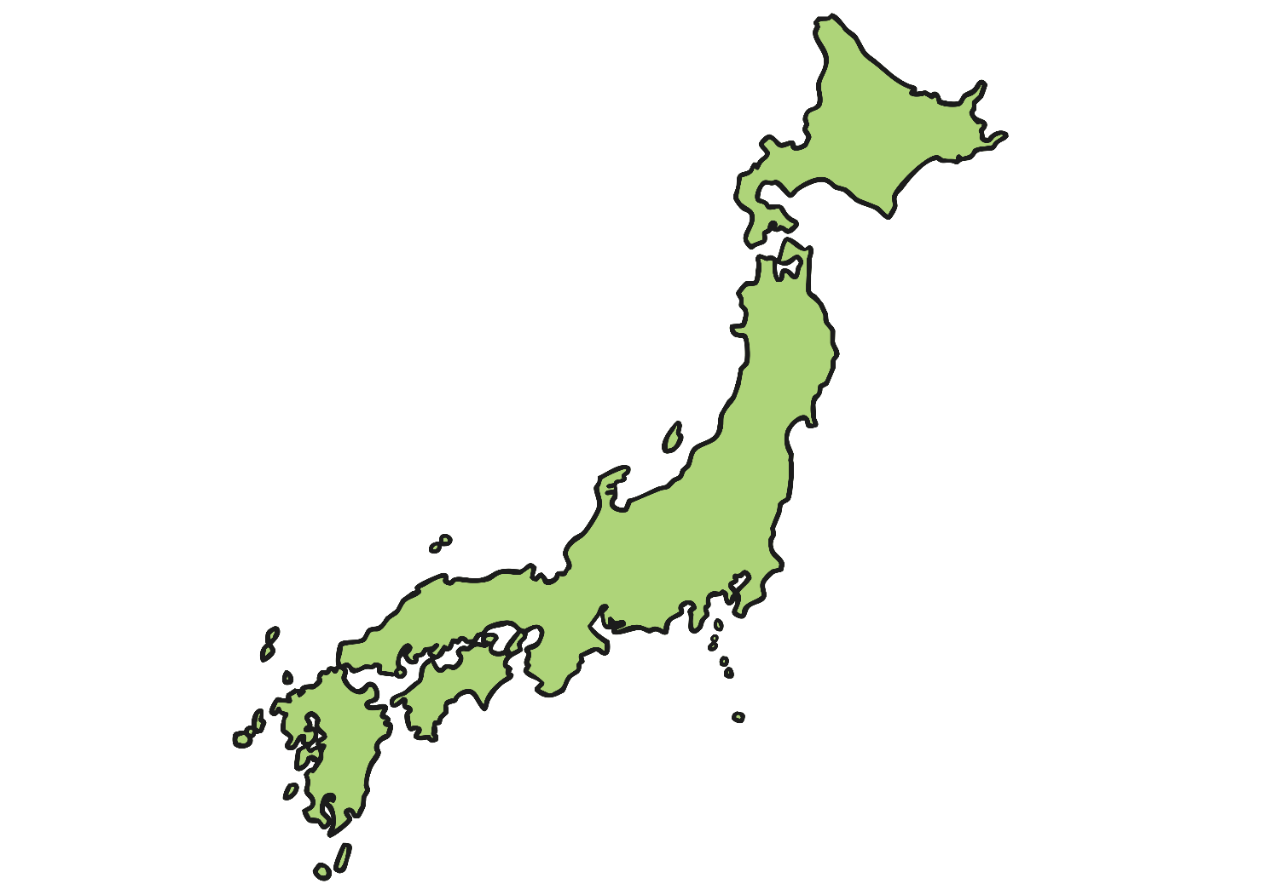
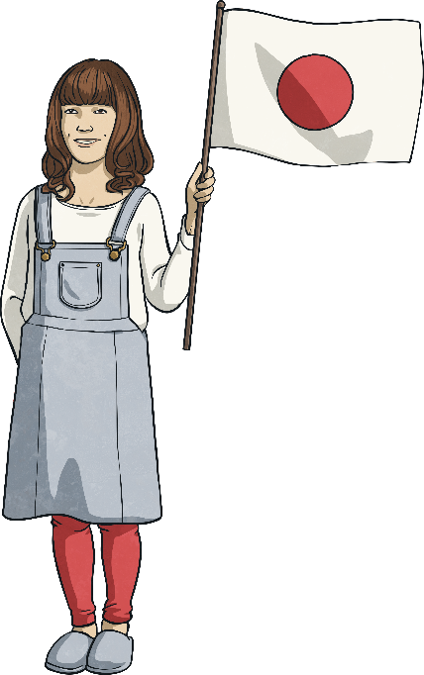
Japan
Japan is located in the Pacific Ocean and is part of the continent of Asia. It is part of an area in the Pacific referred to as the ‘Ring of Fire’ as it is on the edges of continental and oceanic tectonic plates. This means there is a lot of seismic and volcanic which can cause earthquakes and tsunamis.

Slide 3
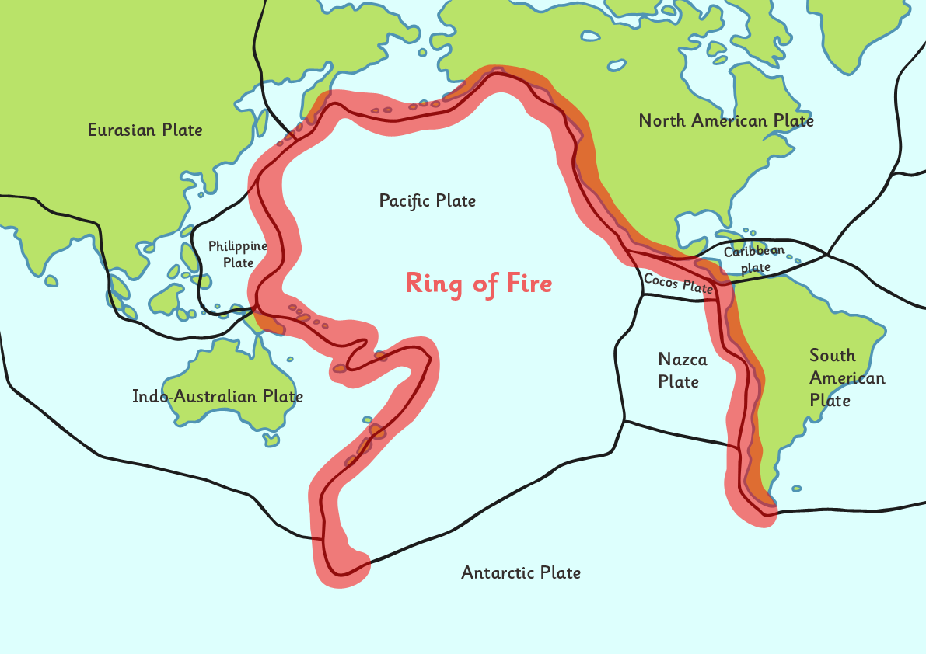
Ring of Fire

Slide 4
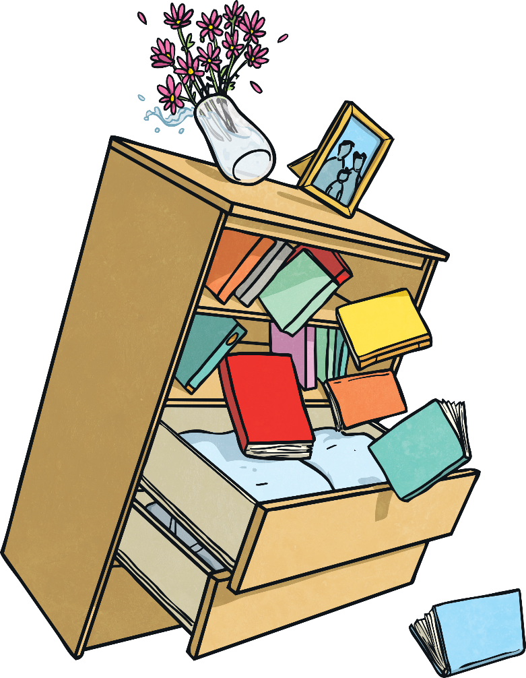
Earthquakes in Japan
Japan is likely to have approximately 1500 earthquakes every year because of its location in the ‘Ring of Fire’.
Earthquakes can cause major damage and destruction to buildings and homes as well as threaten the lives of humans and animals. Earthquakes range in size and magnitude and depending on their severity, they can also cause injury or death.
The vibrations of an earthquake are measured on a seismograph and the strength of the earthquake is measured on the Richter scale which compares their size. Severe earthquakes can also trigger tsunamis.

Slide 5
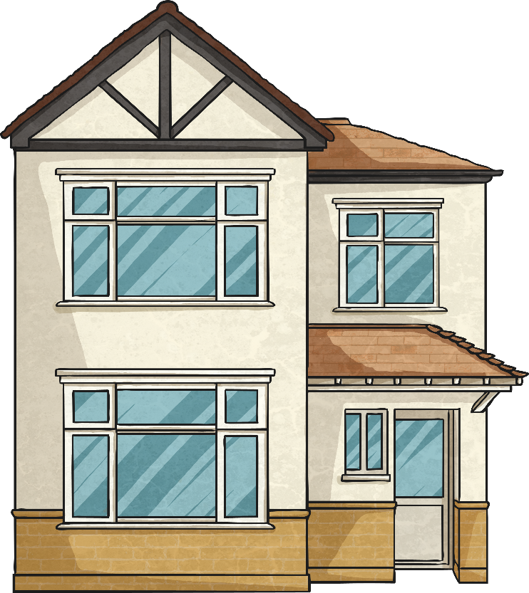
Earthquake Resistant Buildings
Because of the frequency of earthquakes in Japan, earthquake resistant buildings were designed to minimize the impact caused by the seismic waves.
The aim of these earthquake-resistant buildings is to reduce the risk of a building collapse and to protect the people inside a building in the event of an earthquake.
One of the features that engineers create in earthquake-resistant buildings is ‘base isolation’.

Slide 6
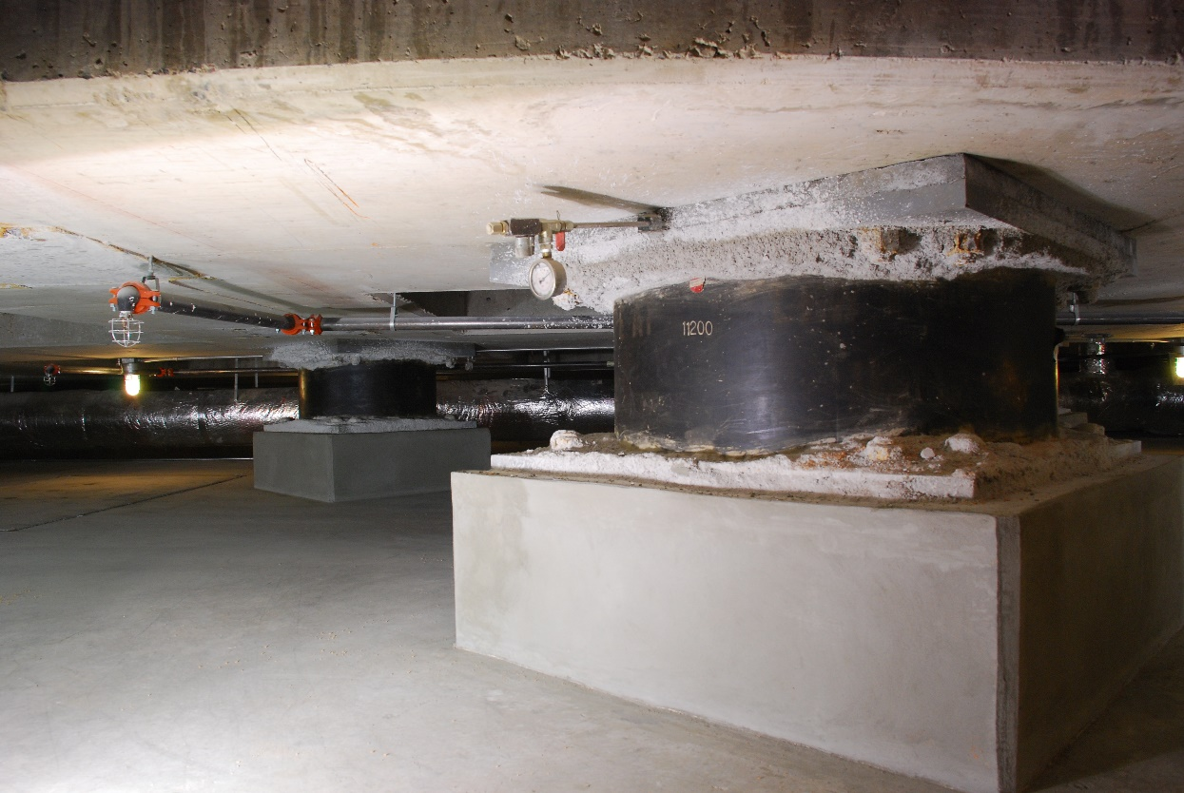
Base Isolation
The base of a building is built above or away from the surface of the ground. It then rests on flexible bearings or pads. This allows the building to move with the motion of the earthquake and reduces the damage to the building.
Photo courtesy of Mike Renlund (@wikimedia.com) - granted under creative commons licence – attribution

Slide 7
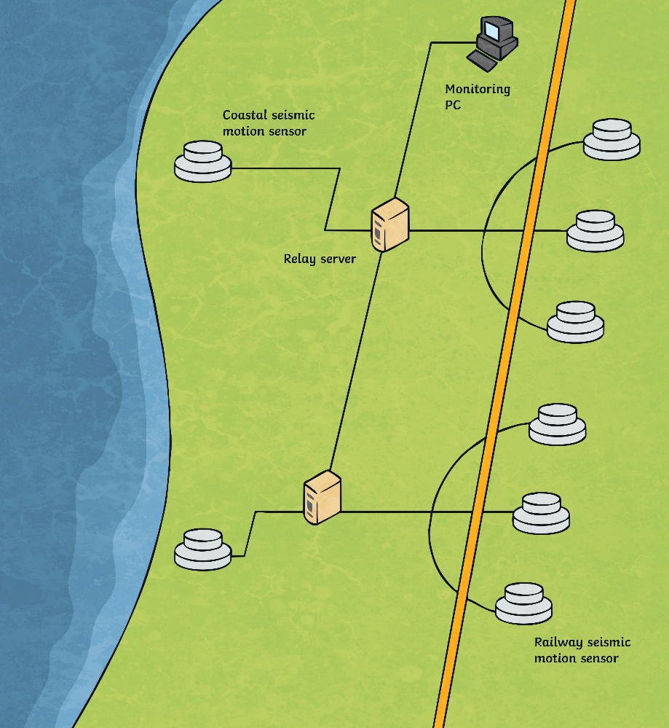
Other Earthquake
Protection Measures
Urgent Earthquake Detection and Alarm System
The Urgent Earthquake Detection and Alarm System (UrEDAS) is a system designed for Japan Railways. Motion sensors are used to detect the beginning of an earthquake, registering small seismic waves.
When seismic waves are detected, power to the train line system is automatically cut off, bringing trains to a stop.

Slide 8
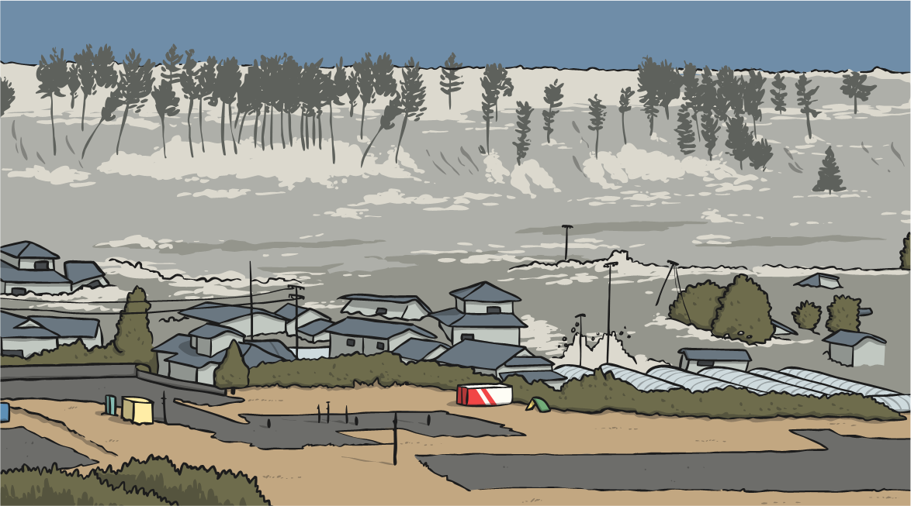
Protection against Tsunamis
A severe earthquake can trigger a tsunami. A tsunami is a large wave caused by a sudden movement of the ocean floor, such as the shock of the seismic activity from an earthquake.
A tsunami can be devastating to life, property and nature. As Japan is extremely susceptible to earthquakes, it has implemented strategies to minimise the damage that tsunamis could cause.

Slide 9
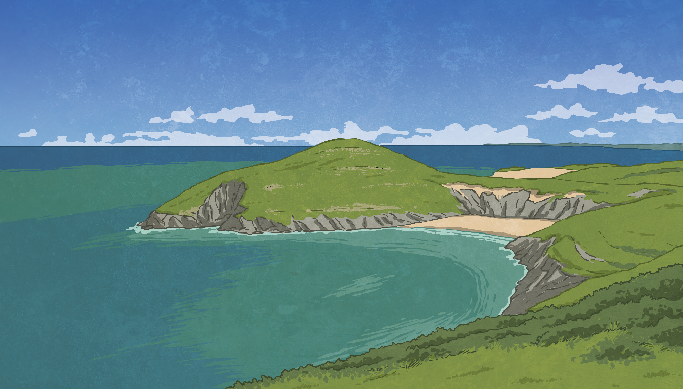
Protection against Tsunamis
Seawall
Thick, high concrete walls have been constructed along on Japan’s coastline where a tsunami might strike the coast. Seawalls have been proven to protect the coastlines from damage and coastlines.
Coastal Forests
Forests along the Japanese coastlines have shown to reduce the destruction and damage caused by a tsunami by absorbing the energy of the wave.

Slide 10
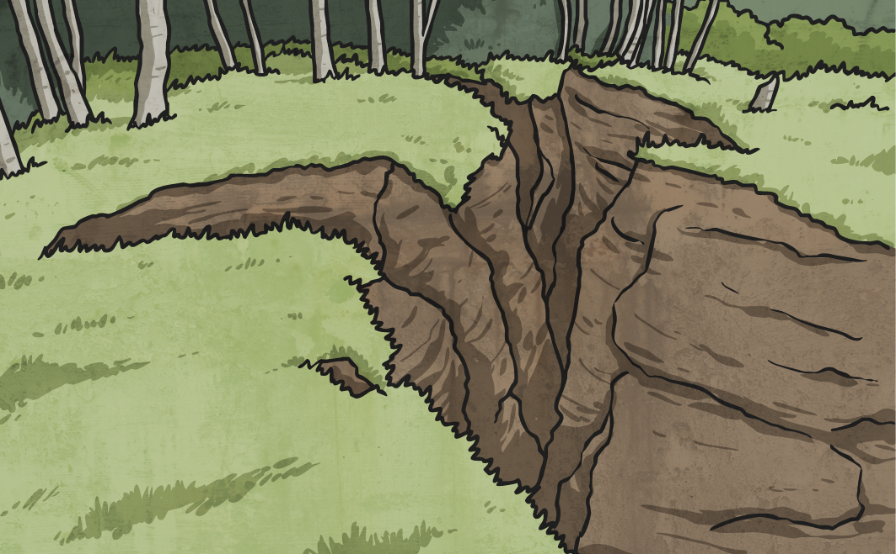
Living With Seismic Activity
Japan’s position in an area of high seismic activity means that living with the threat of earthquakes and tsunamis is a way of life.
Japan’s resourcefulness in designing and building protective measures to cope with such violent natural events shows how people can adapt to live successfully in difficult environmental circumstances.
Earthquakes and tsunamis can’t be stopped, but their impact can be managed.

Slide 11
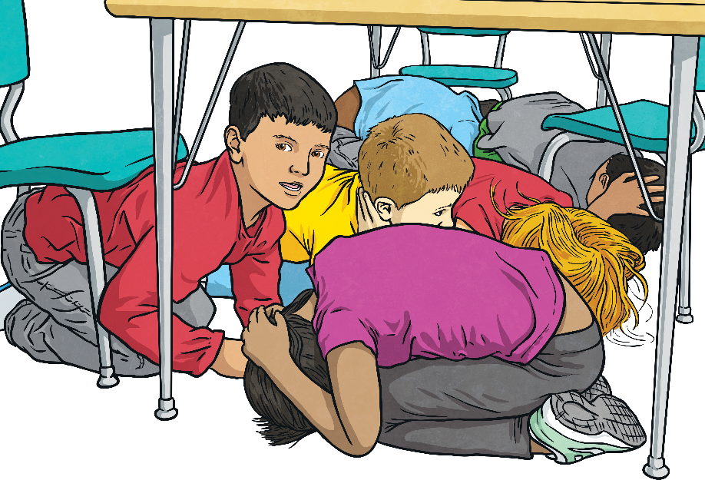
Glossary
Magma – a part of the Earth’s surface below the crust. The rock here is so hot that it is in fluid form. When it reaches the surface, it’s called lava.
Seismic – ground movement caused by an earthquake.
Seismograph – a machine to measure the size and strength of earth movement events such as earthquakes.
Tectonic plates – sections of the Earth’s crust ‘floating’ on magma. They often push against, under or over each other, causing seismic activity.
Volcanic – relating to volcanos.

